Slide 1

Biological Databases: Theories and Practice
430032
PHP Programming I
Instructor: Prof. LEE, Tzong-Yi (李宗夷)
Email: leetzongyi@nycu.edu.ctw
Professor
Institute of Bioinformatics and Systems Biology,
National Yang Ming Chiao Tung University
结合传统与现代
融会中国与西方

Slide 2
Outline
Introduction of PHP programing
Operators
Control Structures
File System functions
Notes:
1

Slide 3
Introduction of PHP programming
PHP (recursive acronym for PHP: Hypertext Preprocessor) is a widely-used open source general-purpose scripting language that is especially suited for web development and can be embedded into HTML.
Techniques for programming dynamic features into Web
Open source scripting language
Available on most computer platforms
The best things in using PHP are that it is extremely simple for a newcomer, but offers many advanced features for a professional programmer.

Slide 4
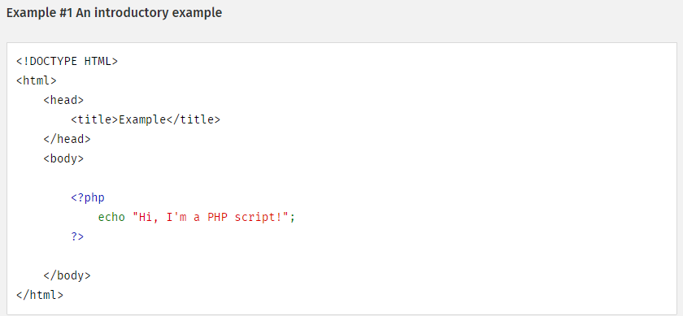
Embedded into HTML
PHP Reference manual: http://php.net/manual/en/index.php

Slide 5
What can PHP do?
Anything.
What distinguishes PHP from something like client-side JavaScript is that the code is executed on the server, generating HTML which is then sent to the client.
PHP is mainly focused on server-side scripting, so you can do anything as other CGI program can do, such as collect form data, generate dynamic page content, or send and receive cookies.
But PHP can do much more.

Slide 6
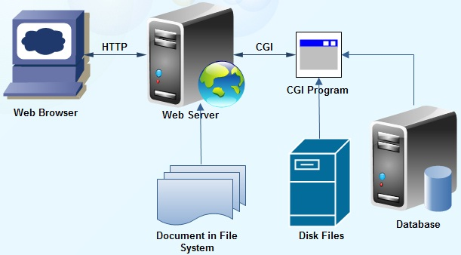
Common Gateway Interface (CGI)
PHP is a sort of common gateway interface (CGI).
PHP or JSP

Slide 7
Three main areas where PHP scripts are used
Server-side scripting
This is the most traditional and main target field for PHP.
Command line scripting
You can make a PHP script to run it without any server or browser.
Writing desktop applications
PHP is probably not the very best language to create a desktop application with a graphical user interface, but if you know PHP very well, you can also use PHP-GTK to write such programs.

Slide 8
Get started
When PHP parses a file, it looks for opening and closing tags, which are <?php and ?> which tell PHP to start and stop interpreting the code between them.
Comments: // or /* … */
Get system information from PHP
<?php phpinfo(); ?>
We are going to check what sort of browser the visitor is using.
<?php echo $_SERVER['HTTP_USER_AGENT']; ?>

Slide 9
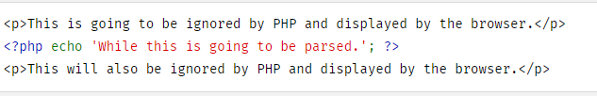
Escaping from HTML
Everything outside of a pair of opening and closing tags is ignored by the PHP parser which allows PHP files to have mixed content. This allows PHP to be embedded in HTML documents, for example to create templates.

Slide 10
Mixing both HTML and PHP modes
<?php if (strpos($_SERVER['HTTP_USER_AGENT'], 'MSIE') !== FALSE) { ?>
<h3>strpos() must have returned non-false</h3> <p>You are using Internet Explorer</p>
<?php } else { ?>
<h3>strpos() must have returned false</h3> <p>You are not using Internet Explorer</p>
<?php } ?>

Slide 11
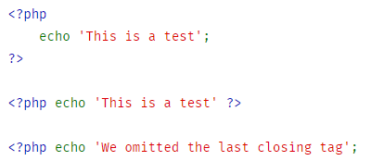
Instruction separation
As in C or Perl, PHP requires instructions to be terminated with a semicolon at the end of each statement.
The closing tag of a block of PHP code automatically implies a semicolon; you do not need to have a semicolon terminating the last line of a PHP block.
The closing tag for the block will include the immediately trailing newline if one is present.

Slide 12
Variable types
http://php.net/manual/en/language.types.php
PHP supports nine primitive types.
Four scalar types:
boolean
integer
float (floating-point number, aka double)
string
Three compound types:
array
object
callable
And finally two special types:
resource
NULL

Slide 13
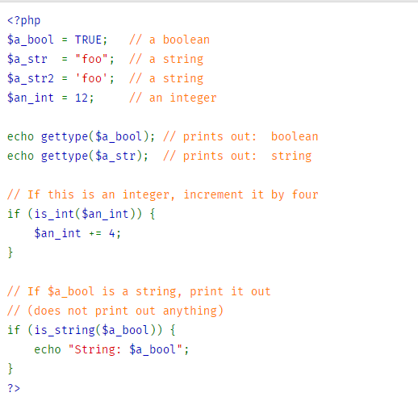

Slide 14
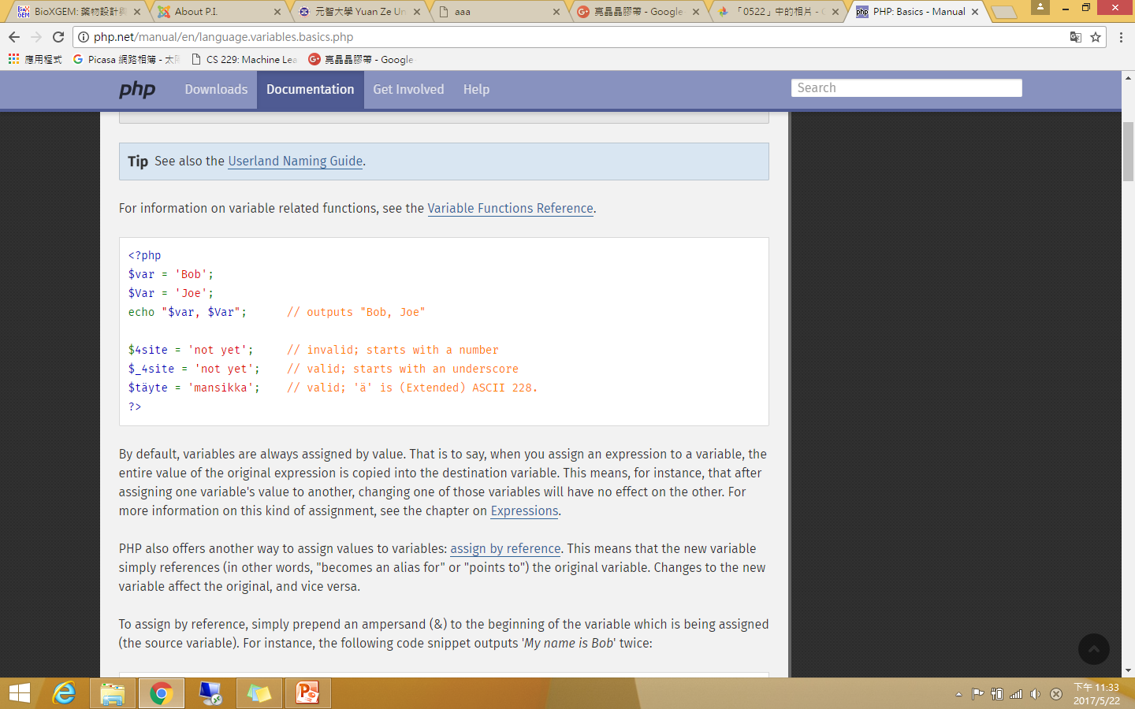
Variables
Variables in PHP are represented by a dollar sign ($) followed by the name of the variable. The variable name is case-sensitive.
Variable name can include characters, letters, and underscore character (_)
Main ways to express strings and text
Single-quoted strings or double-quoted strings

Slide 15
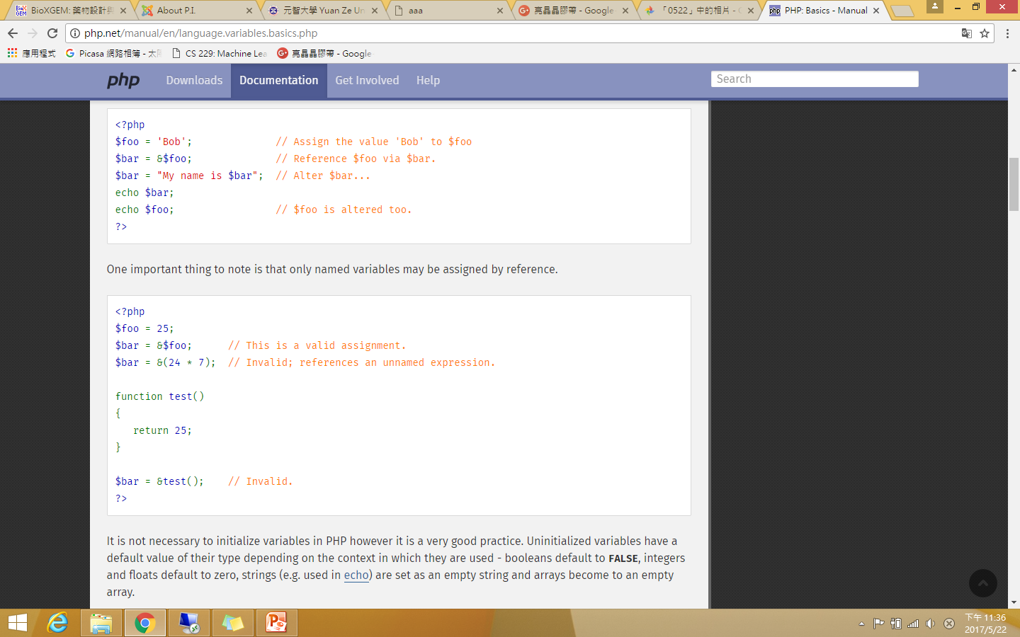
Assign by reference
PHP also offers another way to assign values to variables: assign by reference. This means that the new variable simply references (in other words, "becomes an alias for" or "points to") the original variable. Changes to the new variable affect the original, and vice versa.

Slide 16
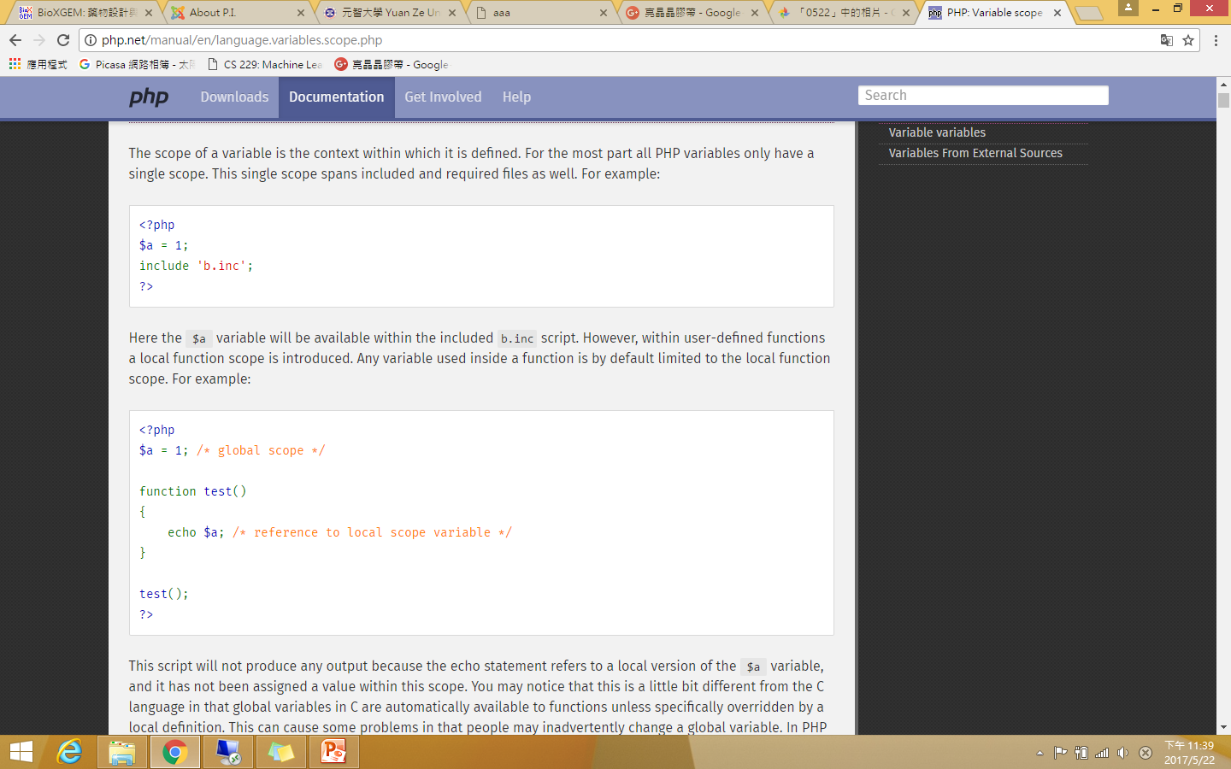
Variable scope
The scope of a variable is the context within which it is defined. For the most part all PHP variables only have a single scope. This single scope spans included and required files as well.
Here the $a variable will be available within the included b.inc script.

Slide 17
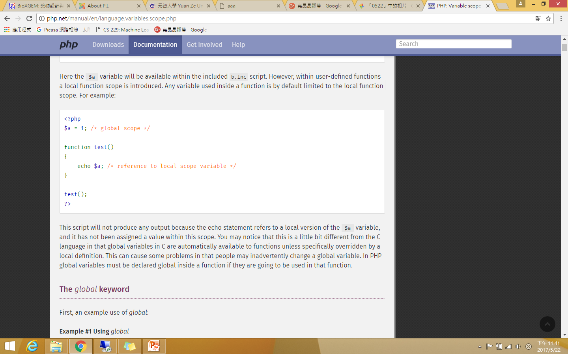
Local variables
However, within user-defined functions a local function scope is introduced. Any variable used inside a function is by default limited to the local function scope.
This script will not produce any output because the echo statement refers to a local version of the $a variable, and it has not been assigned a value within this scope.

Slide 18
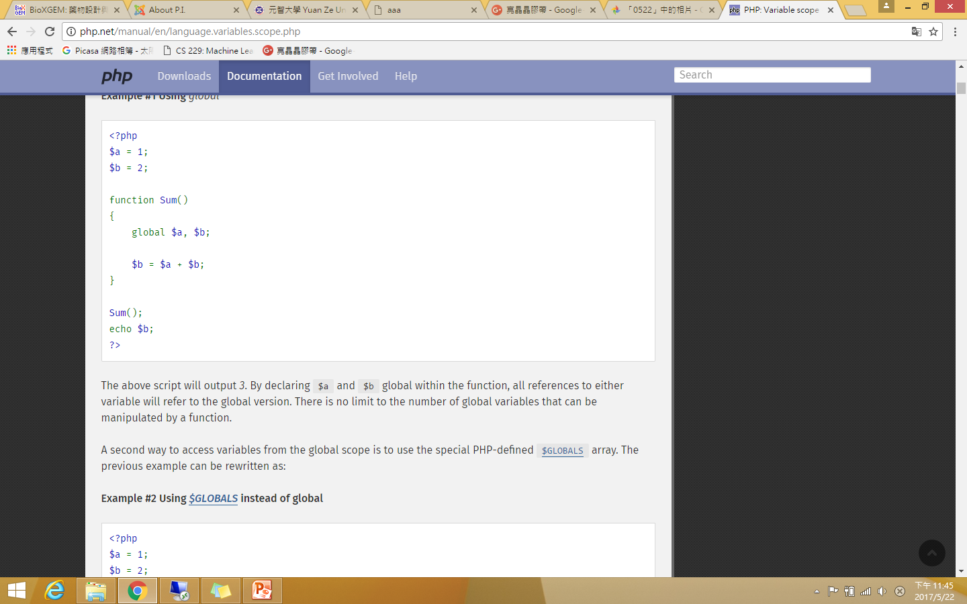
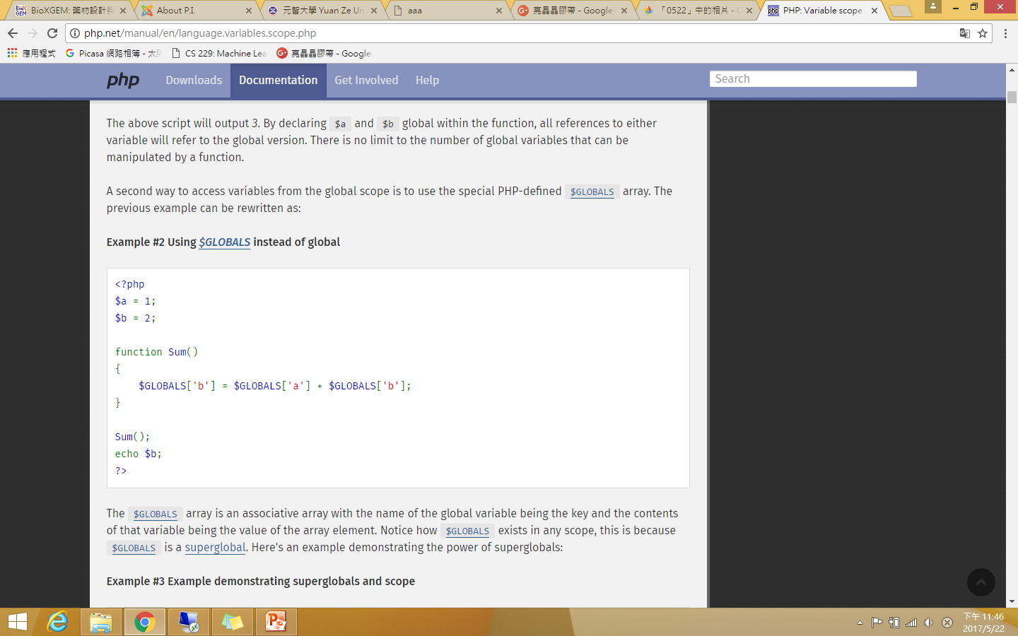
Global variables
Case 1:
Case 2:
The $GLOBALS array is an associative array with the name of the global variable being the key and the contents of that variable being the value of the array element. Notice how $GLOBALS exists in any scope, this is because $GLOBALS is a superglobal.
The above script will output 3. By declaring $a and $b global within the function, all references to either variable will refer to the global version.

Slide 19

Variable variables
Sometimes it is convenient to be able to have variable variable names. That is, a variable name which can be set and used dynamically.

Slide 20
PHP arrays
Numeric array
Associates a numeric index with each element in the array
Indexes are integer numbers
Start at zero
Grow incrementally
Associative array
Provides pairs of (key => value) elements
An array can be created using the array() language construct.
array(
key => value,
key2 => value2,
key3 => value3,
...
)

Slide 21
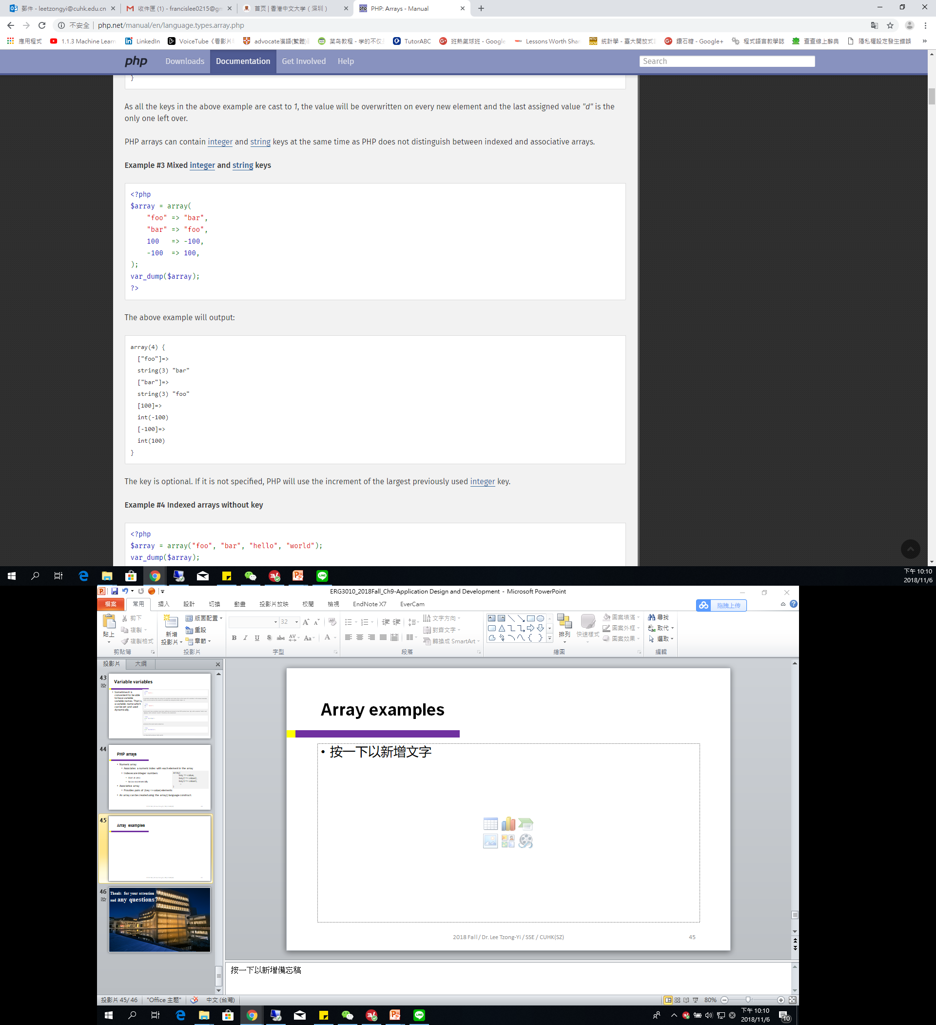
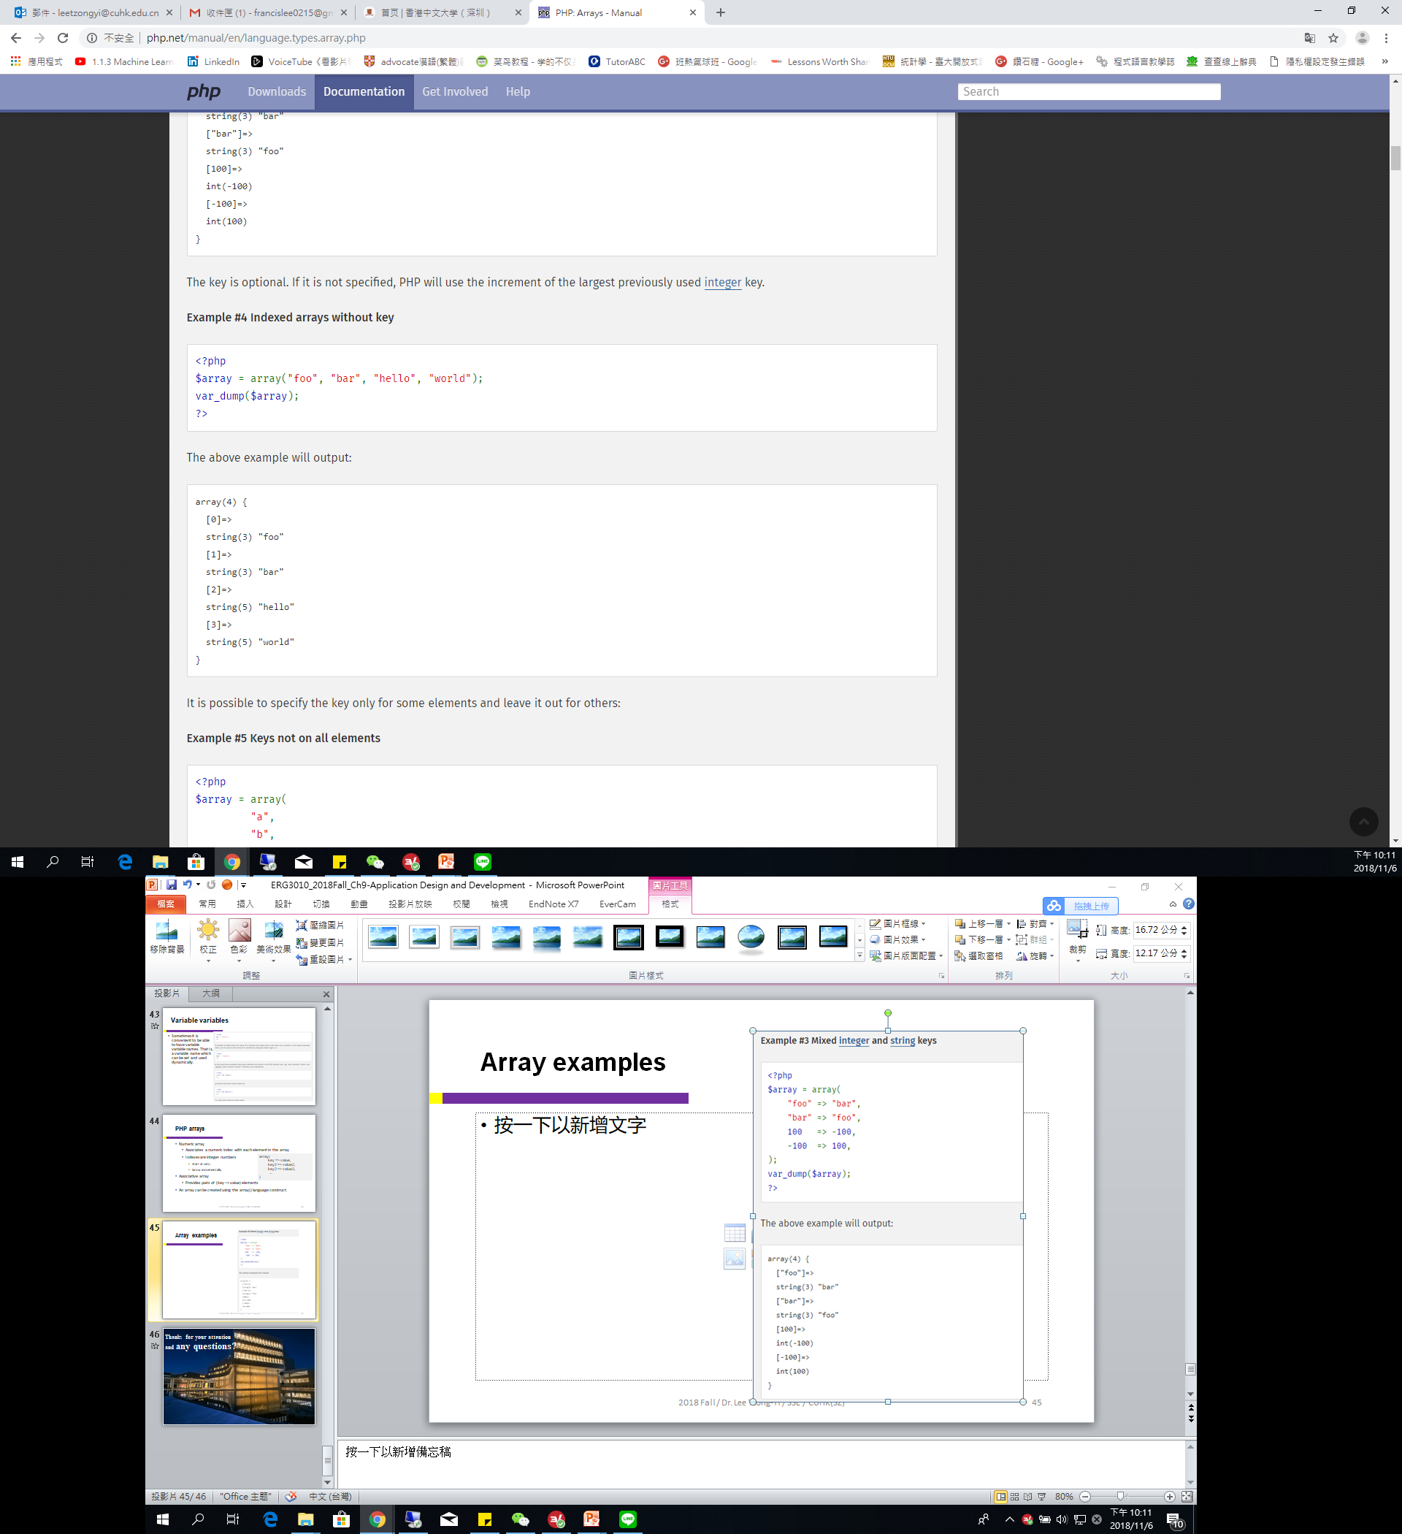
Array examples

Slide 22
Operator Precedence
The precedence of an operator specifies how "tightly" it binds two expressions together.
In the expression 1 + 5 * 3, the answer is 16 and not 18 because the multiplication ("*") operator has a higher precedence than the addition ("+") operator. Parentheses may be used to force precedence, if necessary. For instance: (1 + 5) * 3 evaluates to 18.

Slide 23
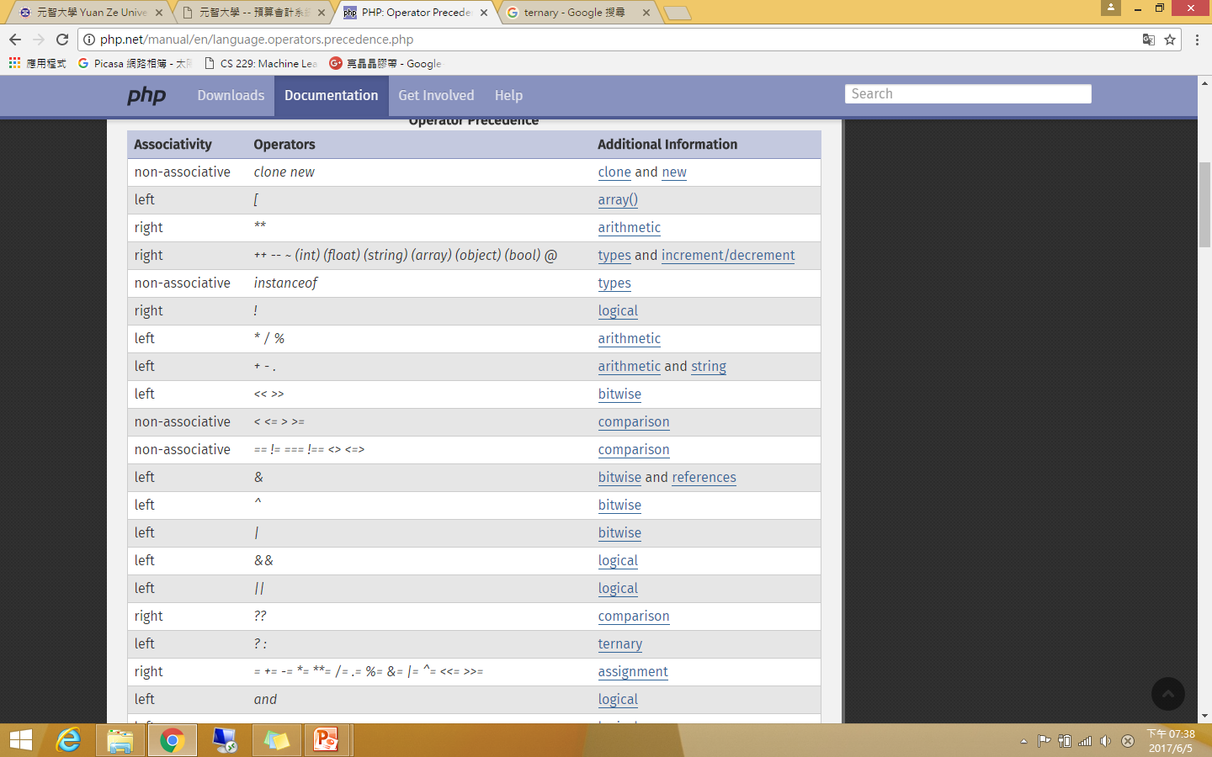
Operator Precedence

Slide 24
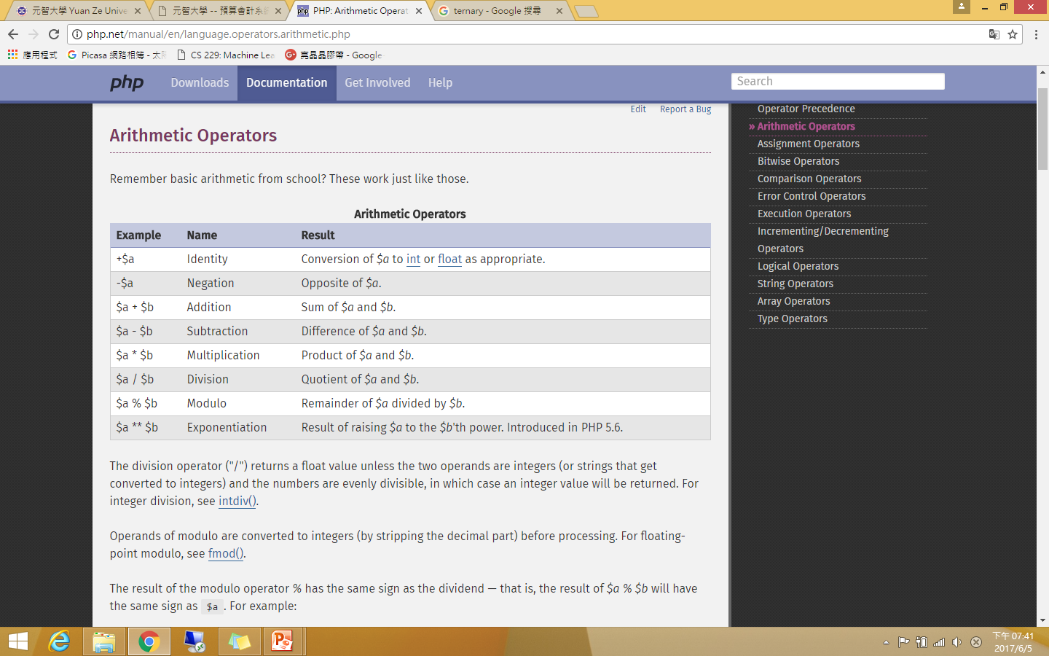
Arithmetic Operators
The division operator ("/") returns a float value unless the two operands are integers (or strings that get converted to integers) and the numbers are evenly divisible, in which case an integer value will be returned.

Slide 25
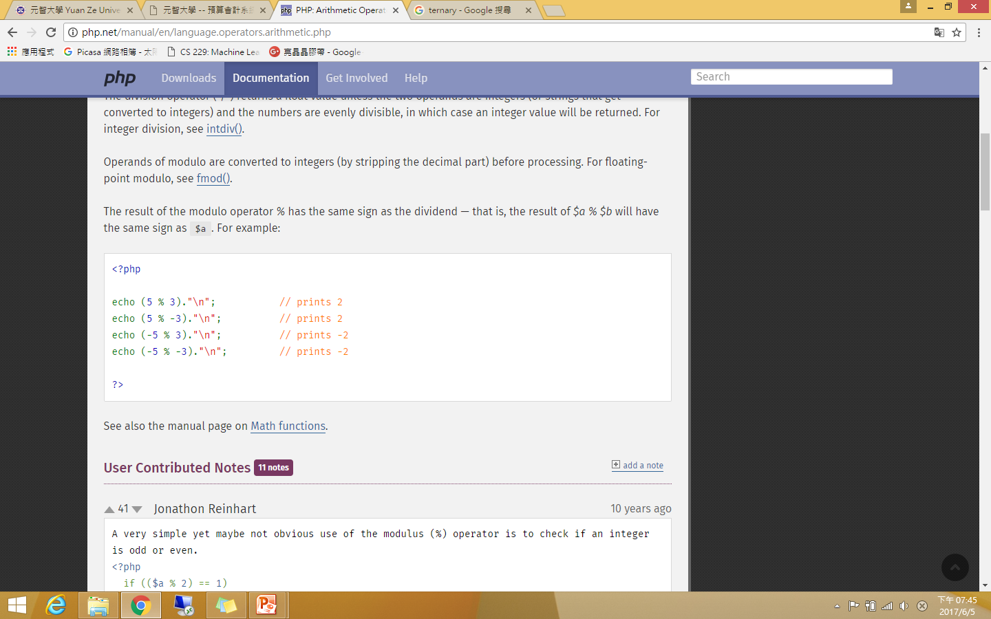
Modulo operator %
Operands of modulo are converted to integers (by stripping the decimal part) before processing. For floating-point modulo, see fmod().

Slide 26
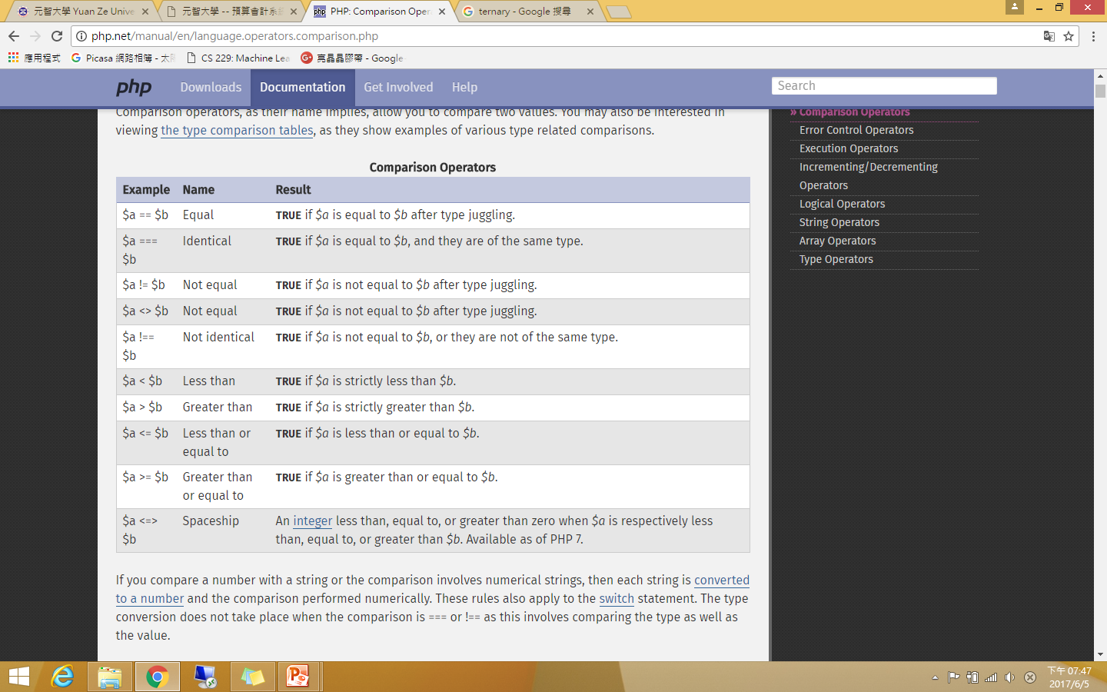
Comparison Operators

Slide 27
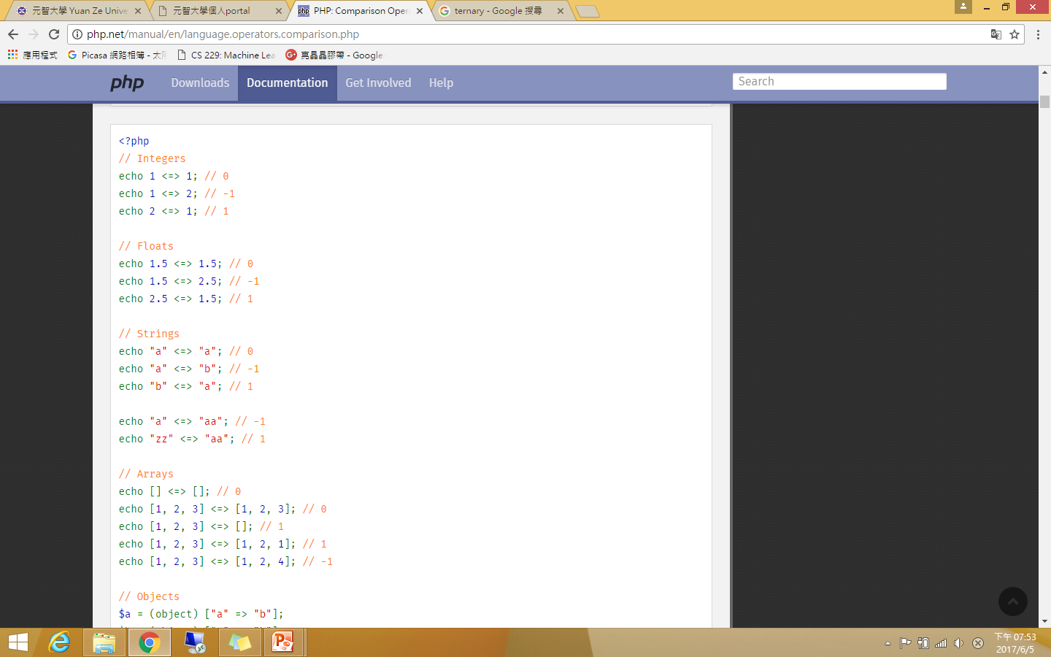
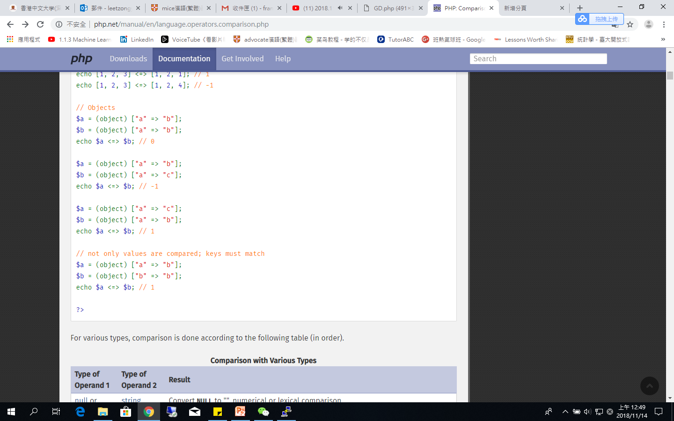

Slide 28
Execution Operators
PHP supports one execution operator: backticks (``).
Note that these are not single-quotes!
PHP will attempt to execute the contents of the backticks as a shell command; the output will be returned.
Use of the backtick operator is identical to shell_exec().
Ex:
<?php $output = `ls -al`; echo "<pre>$output</pre>"; ?>

Slide 29
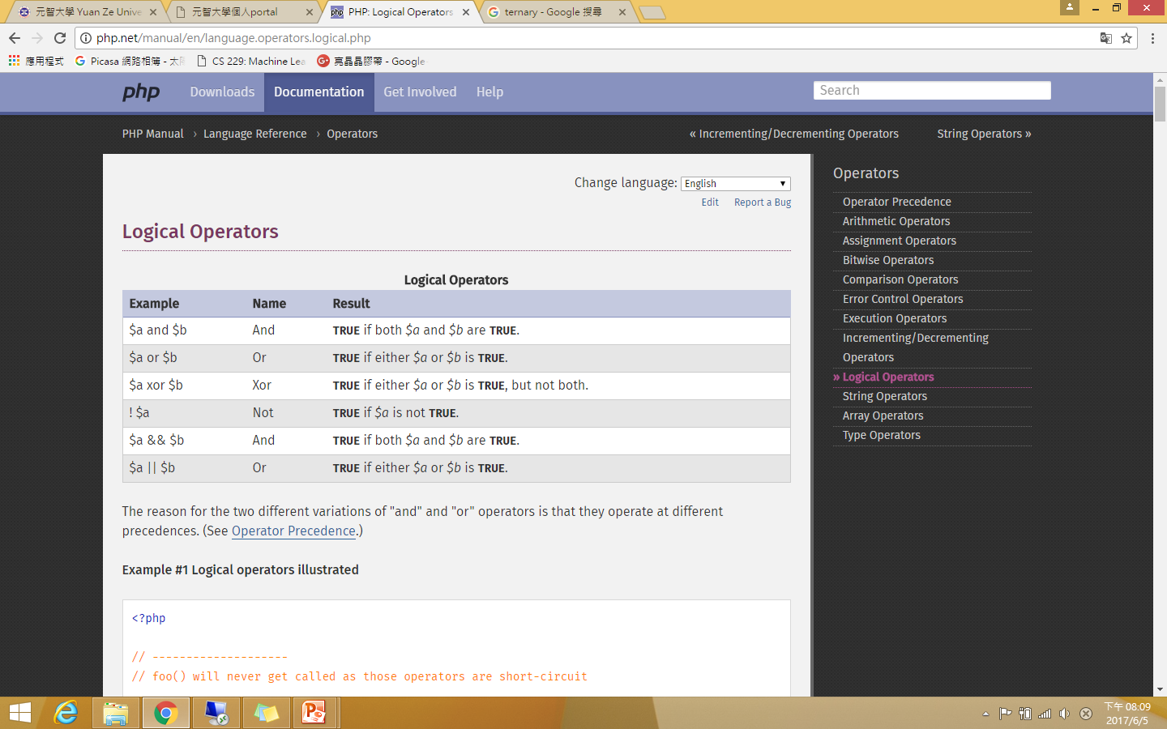
Logical Operators

Slide 30
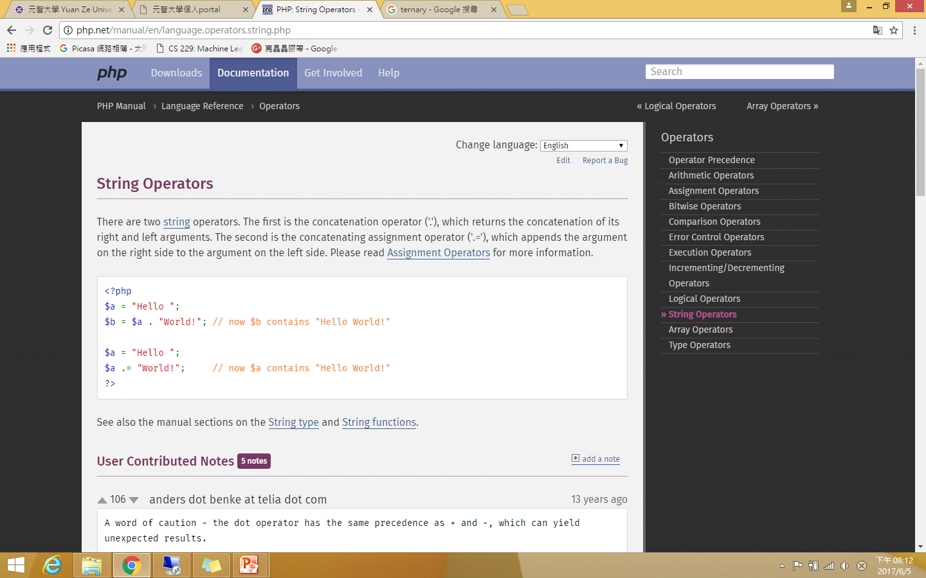
String Operators
There are two string operators. The first is the concatenation operator ('.'), which returns the concatenation of its right and left arguments. The second is the concatenating assignment operator ('.='), which appends the argument on the right side to the argument on the left side.

Slide 31
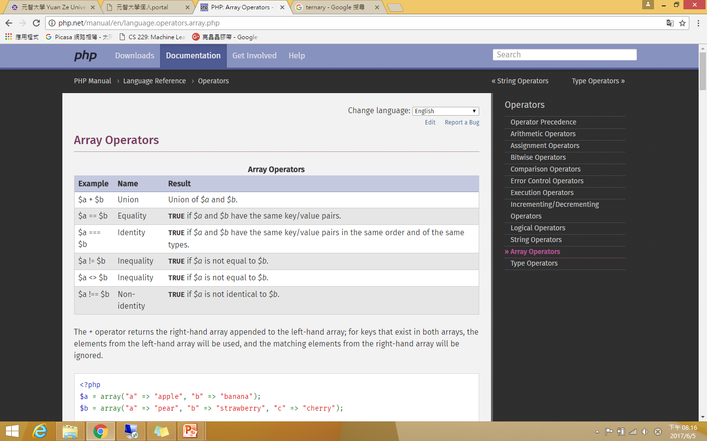
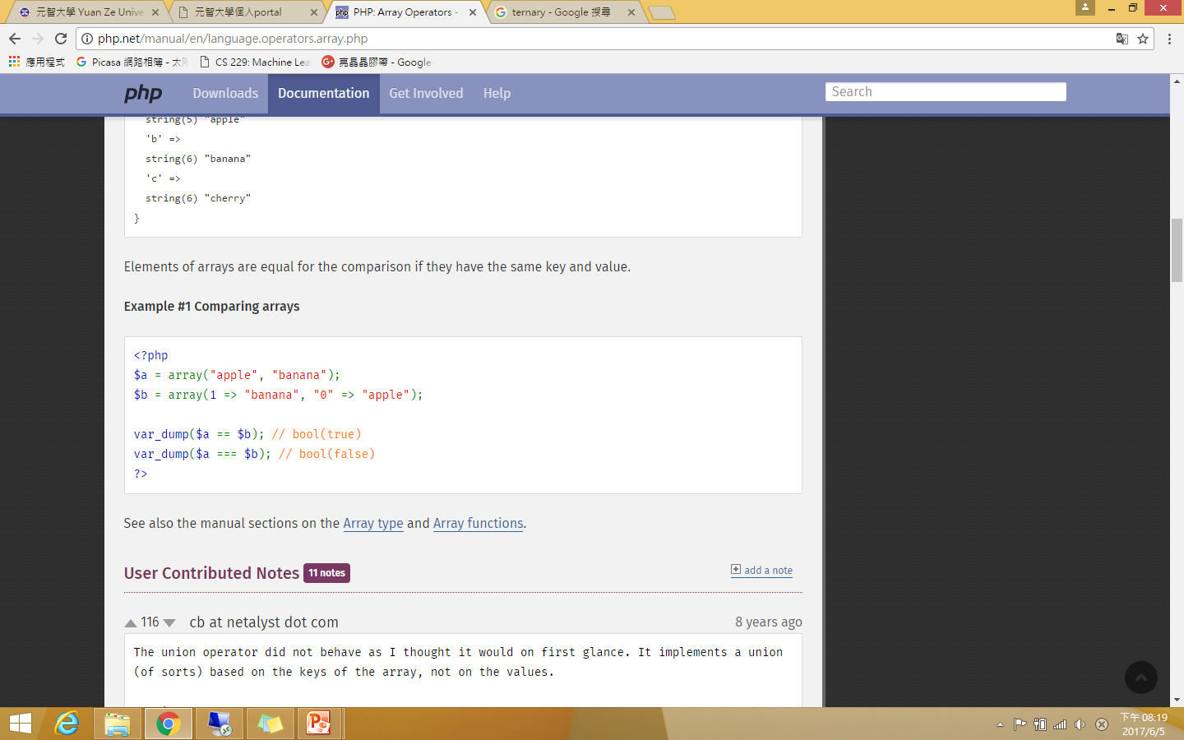
Array Operators

Slide 32
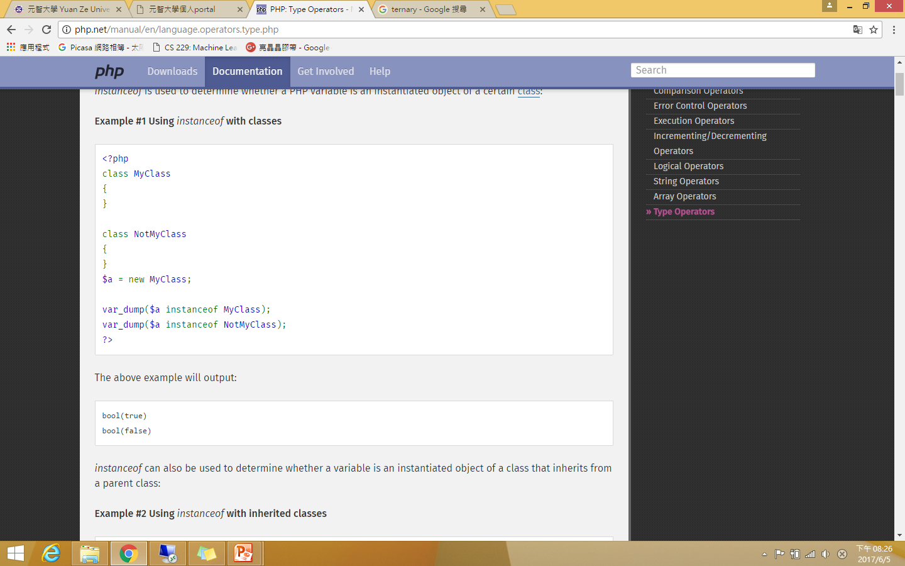
Type Operators
instanceof is used to determine whether a PHP variable is an instantiated object of a certain class.

Slide 33
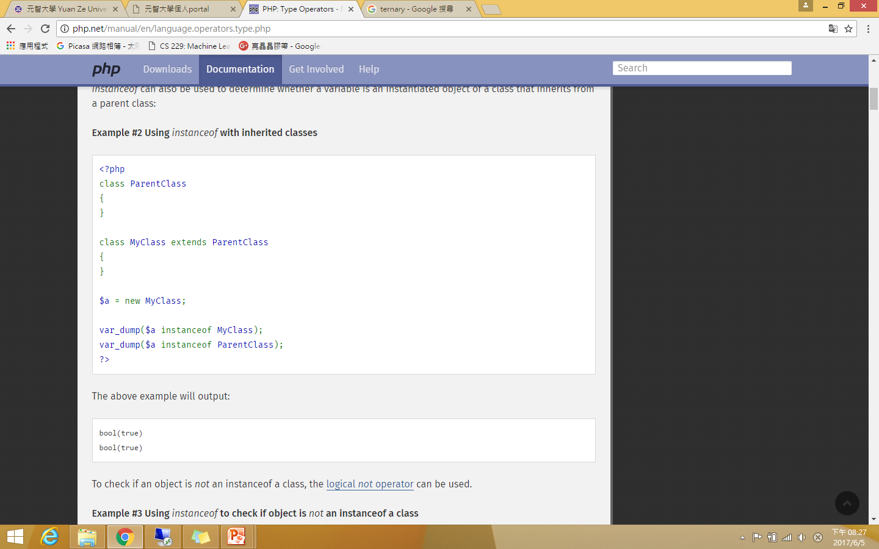

Slide 34
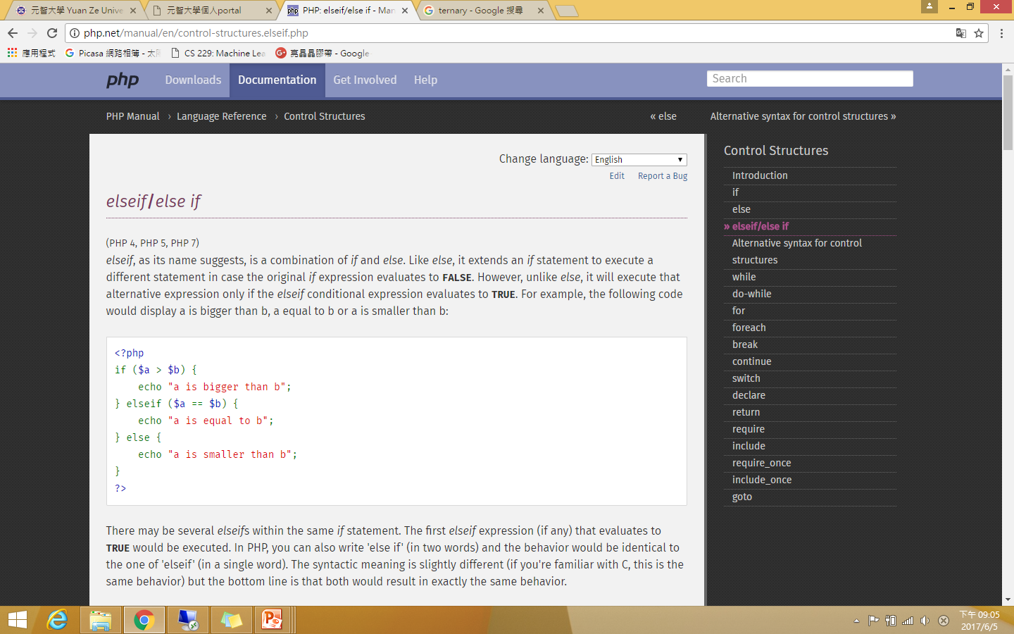
If, else, and else if
The if construct is one of the most important features of many languages, PHP included. It allows for conditional execution of code fragments. PHP features an if structure that is similar to that of C:
if (expr) statement
If expression evaluates to TRUE, PHP will execute statement, and if it evaluates to FALSE - it'll ignore it.

Slide 35
While
while loops are the simplest type of loop in PHP. The basic form of a while statement is:
while (expr) statement
The meaning of a while statement is simple. It tells PHP to execute the nested statement(s) repeatedly, as long as the while expression evaluates to TRUE.

Slide 36
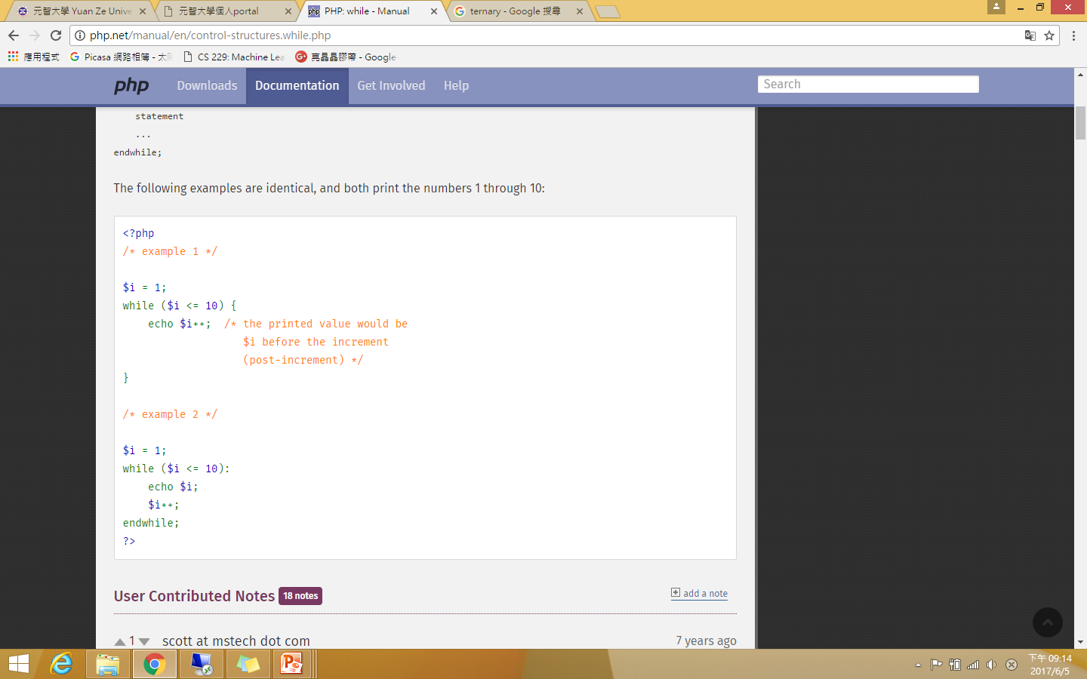

Slide 37
For
for loops are the most complex loops in PHP. The syntax of a for loop is:
for (expr1; expr2; expr3) statement
The first expression (expr1) is evaluated (executed) once unconditionally at the beginning of the loop.
In the beginning of each iteration, expr2 is evaluated. If it evaluates to TRUE, the loop continues and the nested statement(s) are executed. If it evaluates to FALSE, the execution of the loop ends.
At the end of each iteration, expr3 is evaluated (executed).

Slide 38
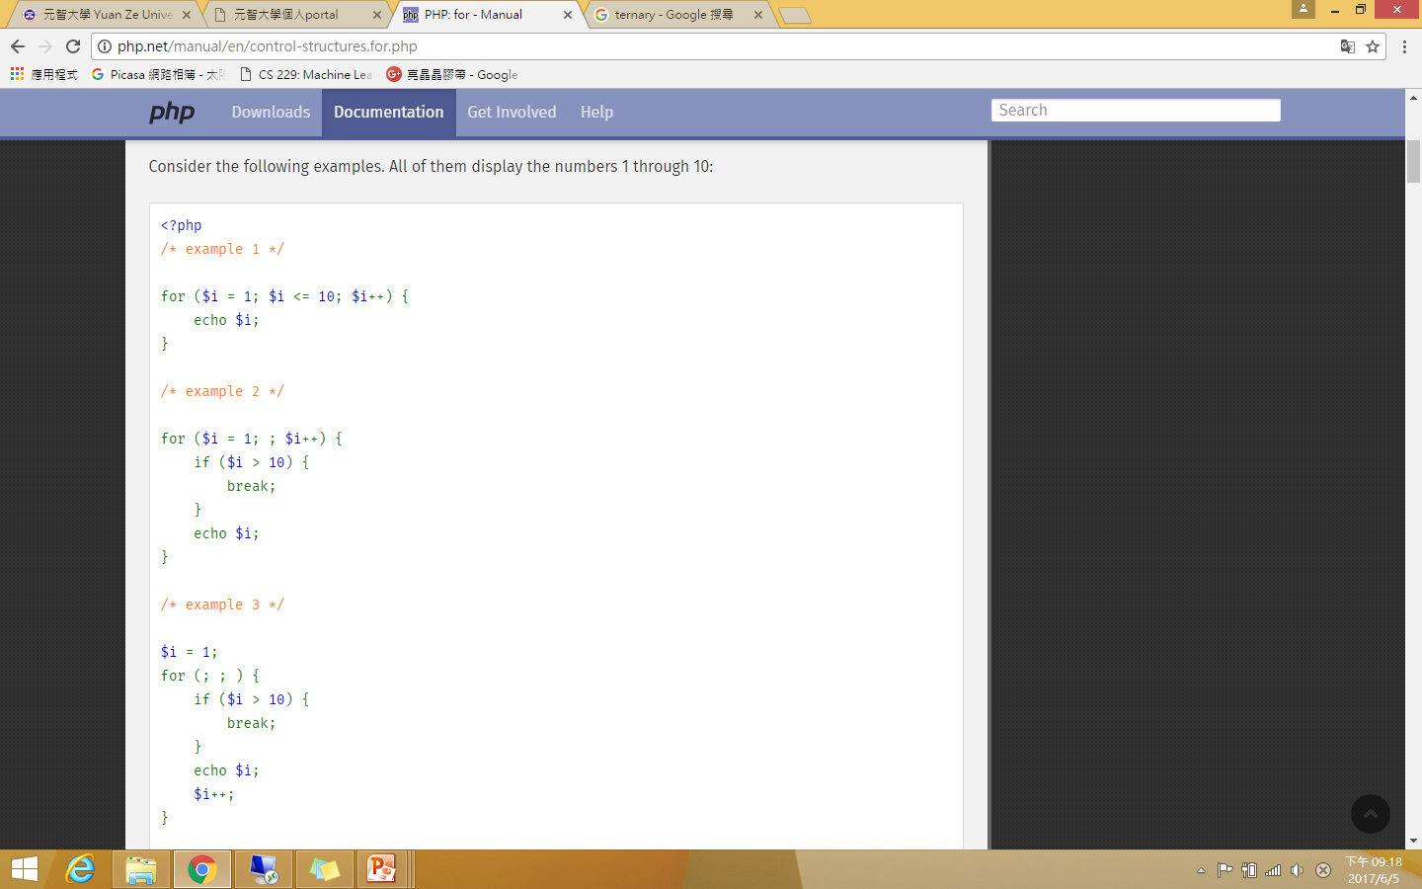

Slide 39
Switch and break
The switch statement is similar to a series of IF statements on the same expression. In many occasions, you may want to compare the same variable (or expression) with many different values, and execute a different piece of code depending on which value it equals to.

Slide 40
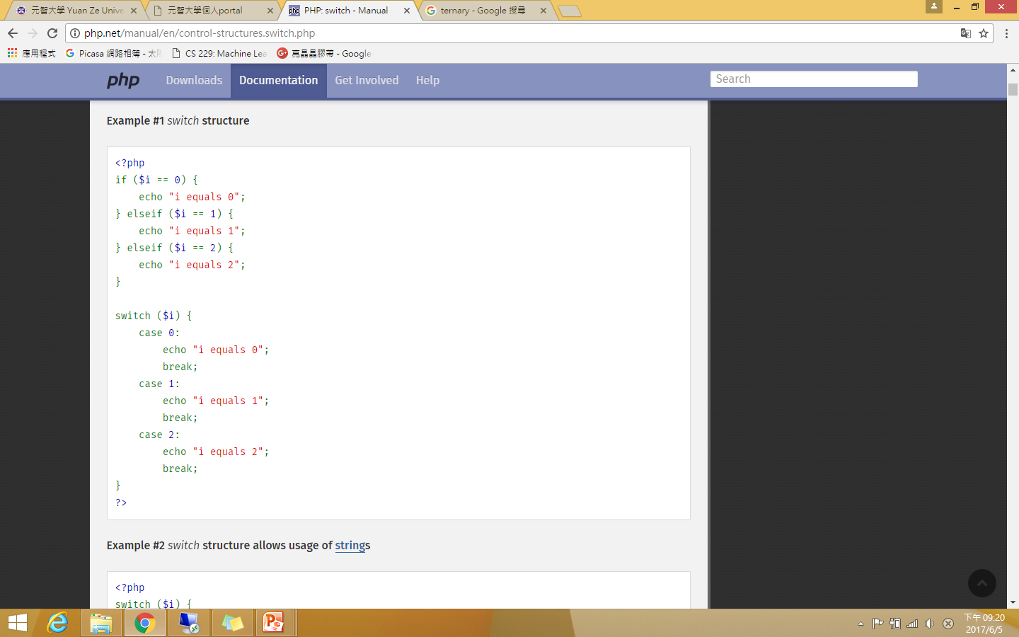

Slide 41
Include
When a file is included, the code it contains inherits the variable scope of the line on which the include occurs.
Any variables available at that line in the calling file will be available within the called file, from that point forward. However, all functions and classes defined in the included file have the global scope.

Slide 42
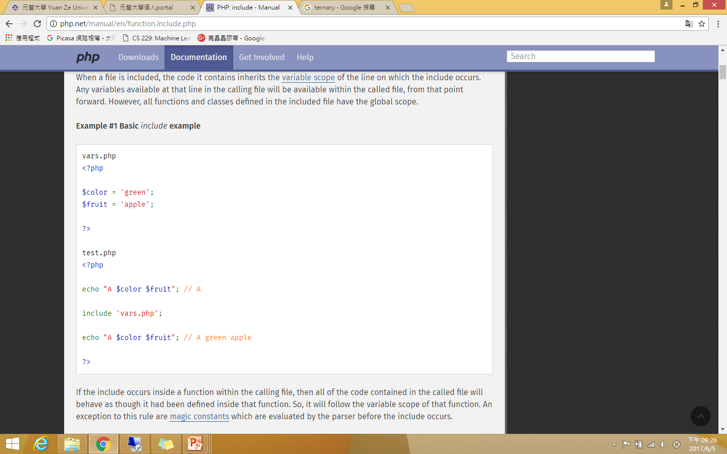
Any variables available at that line in the calling file will be available within the called file, from that point forward

Slide 43
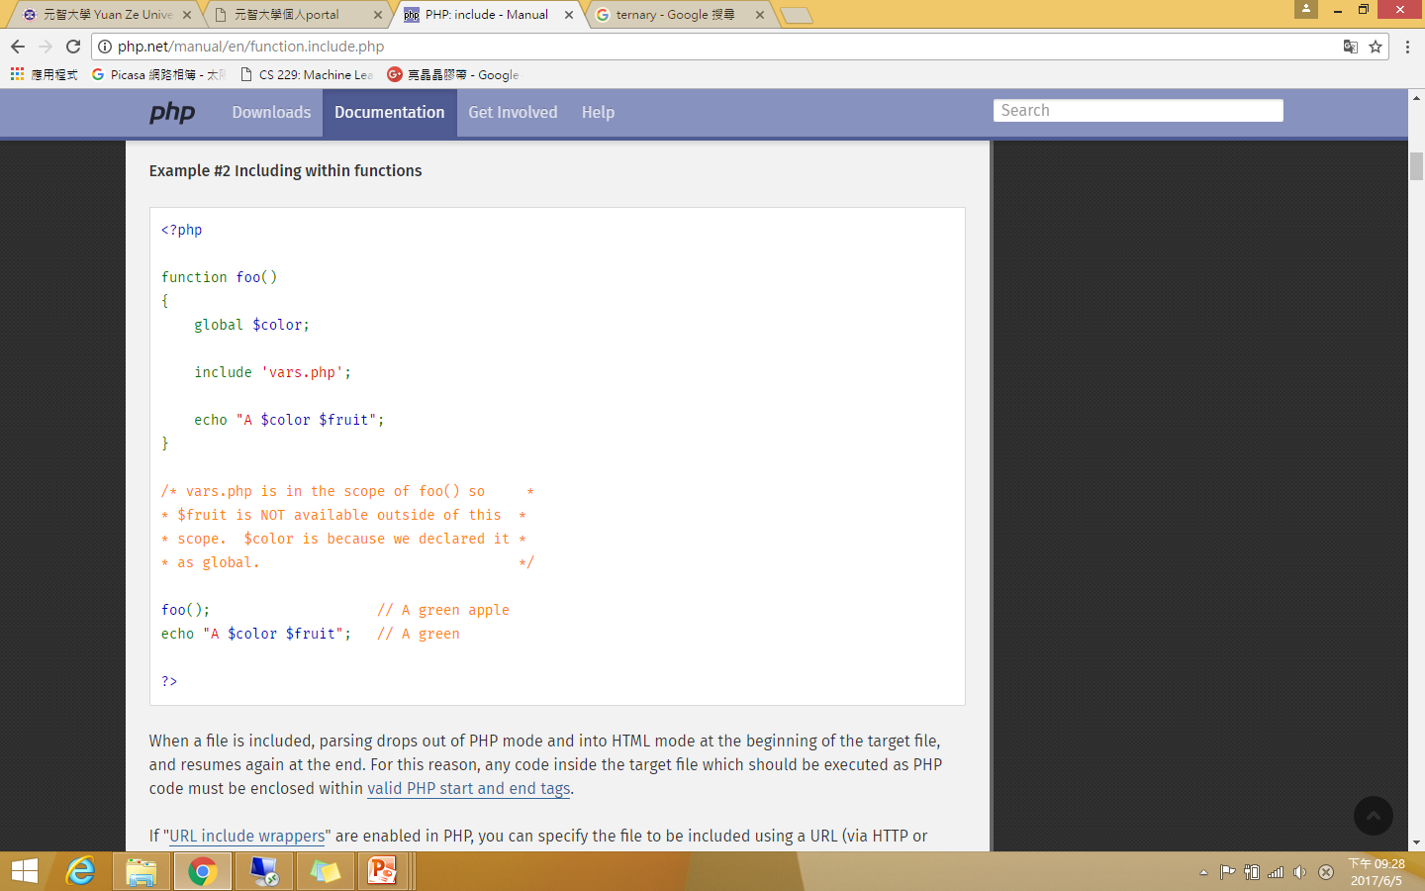

Slide 44
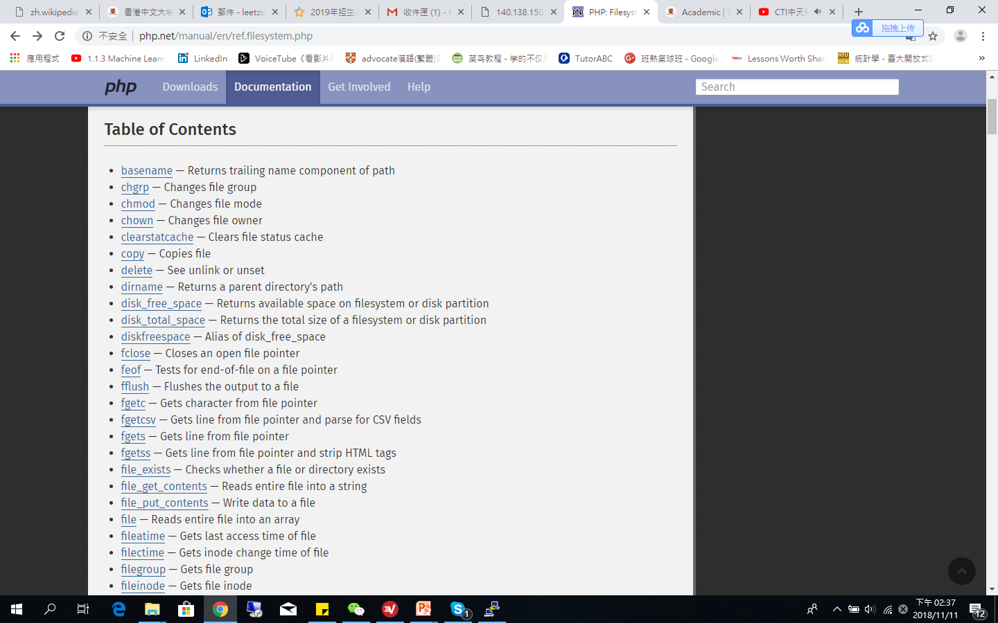
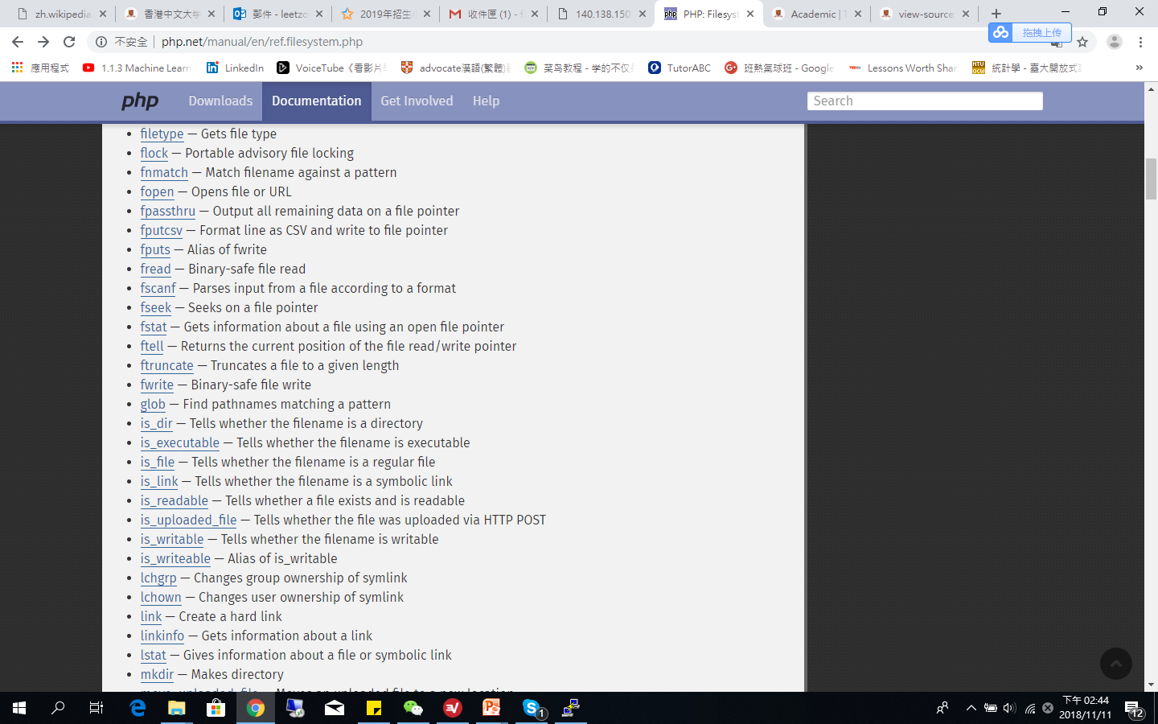
File systems
Filesystem functions: http://php.net/manual/en/ref.filesystem.php

Slide 45
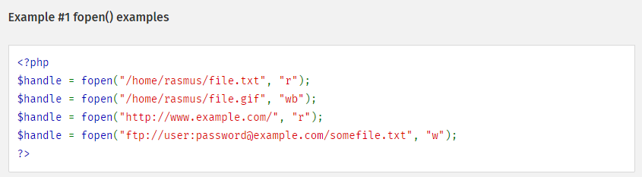
Opening a file: fopen()
Opening a file resource
resource fopen ( string $filename , string $mode)

Slide 46
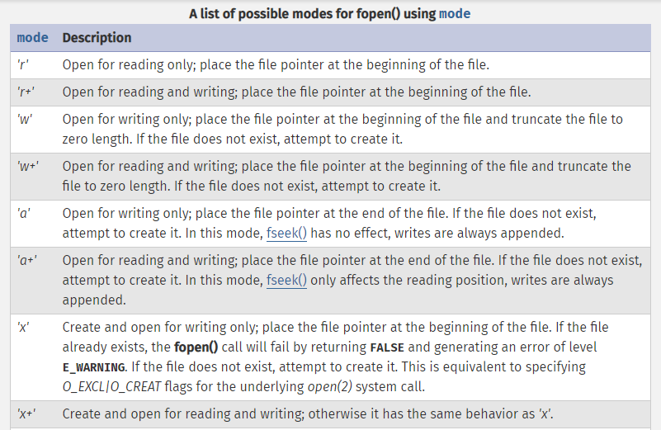

Slide 47
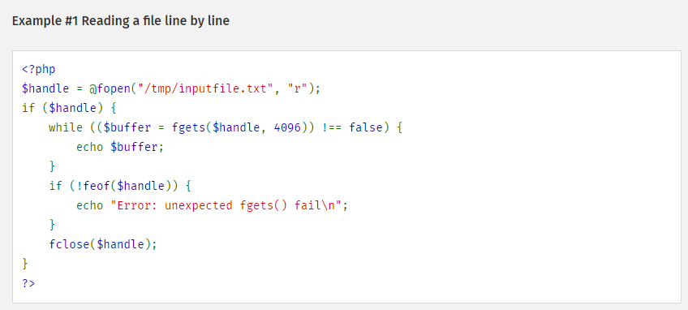
Gets the content from file: fgets()
The fgets() function can get the content from file pointer line by line.
string fgets ( resource $handle [, int $length ] )

Slide 48
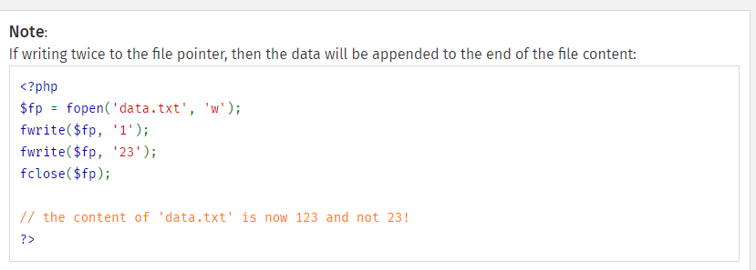
Write contents into a file: fwrite()
The fwrite() function can write the contents of string to the file stream pointed to by handle.
A file system pointer resource that is typically created using fopen().
int fwrite ( resource $handle , string $string [, int $length ] )

Slide 49
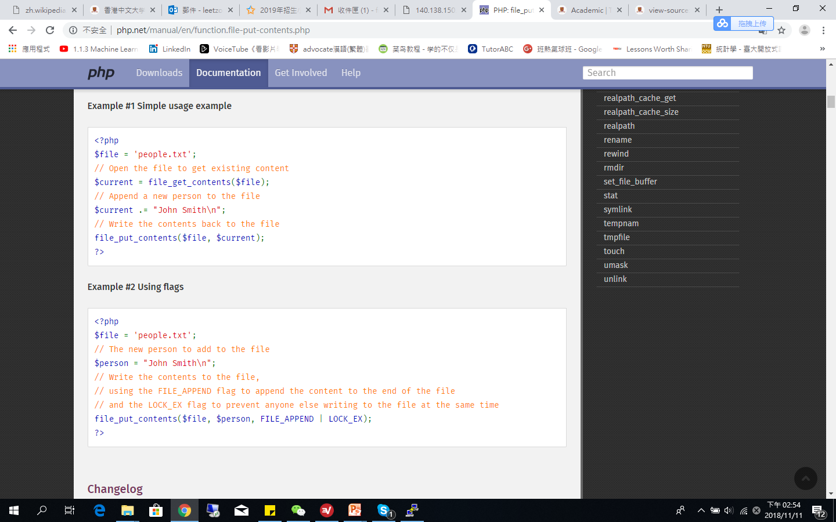
Write data to a file: file_put_contents()
This function is identical to calling fopen(), fwrite() and fclose() successively to write data to a file.

Slide 50
file_put_contents(): using flags

Slide 51
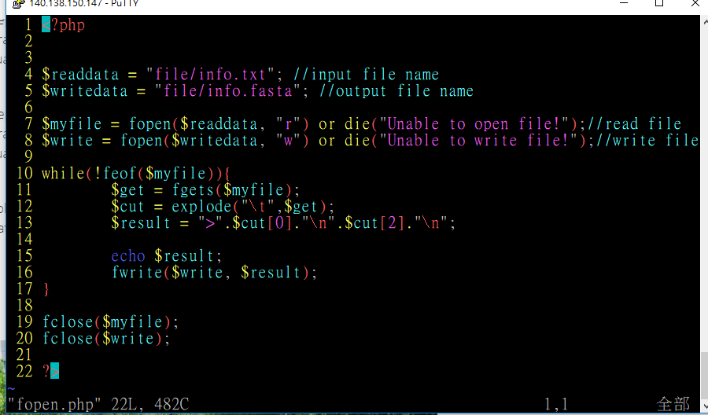
Practice for reading and writing files
Execute “php fopen.php” on linux server.

Slide 52

Thank you and
any questions?

